Slide 1
Transcriptomic response to Netrin-1
in primary rat cortical neurons
Bulk RNA-seq across DIV1, DIV2 and DIV2 + Netrin-1 | 3 conditions x 3 biological replicates
[Presenter] | [Affiliation] | June 2026
Notes:
开场：本研究用 bulk RNA-seq 研究 Netrin-1 对大鼠皮层原代神经元的转录组作用。3 条件（DIV1 / DIV2 / DIV2+Netrin-1）× 3 生物学重复。主对比=Netrin 处理效应；次对比=发育时间轴。强调：混合培养，核心是区分神经元直接效应与胶质间接效应。

Slide 2
The question: what does Netrin-1 do to the neuronal transcriptome?
Netrin-1 is a canonical axon-guidance cue, signalling through DCC / UNC5 / Neogenin receptors.
Its acute effects (growth-cone steering, local translation) are well known; its 24 h transcriptional program in cortical neurons is not.
Primary cortical cultures are mixed (neurons + glia), so a central challenge is separating neuron-intrinsic effects from glial / indirect ones.
Goal: define the Netrin-1 transcriptional response and attribute each signal to its likely cellular source.
Notes:
Netrin-1 是经典轴突导向配体（DCC / UNC5 / Neogenin）。急性效应（生长锥导向、局部翻译）清楚，但 24h 转录组程序未知。混合培养的核心挑战是把信号归到正确的细胞来源。本报告目标：刻画 Netrin 转录响应并做细胞来源归因。

Slide 3
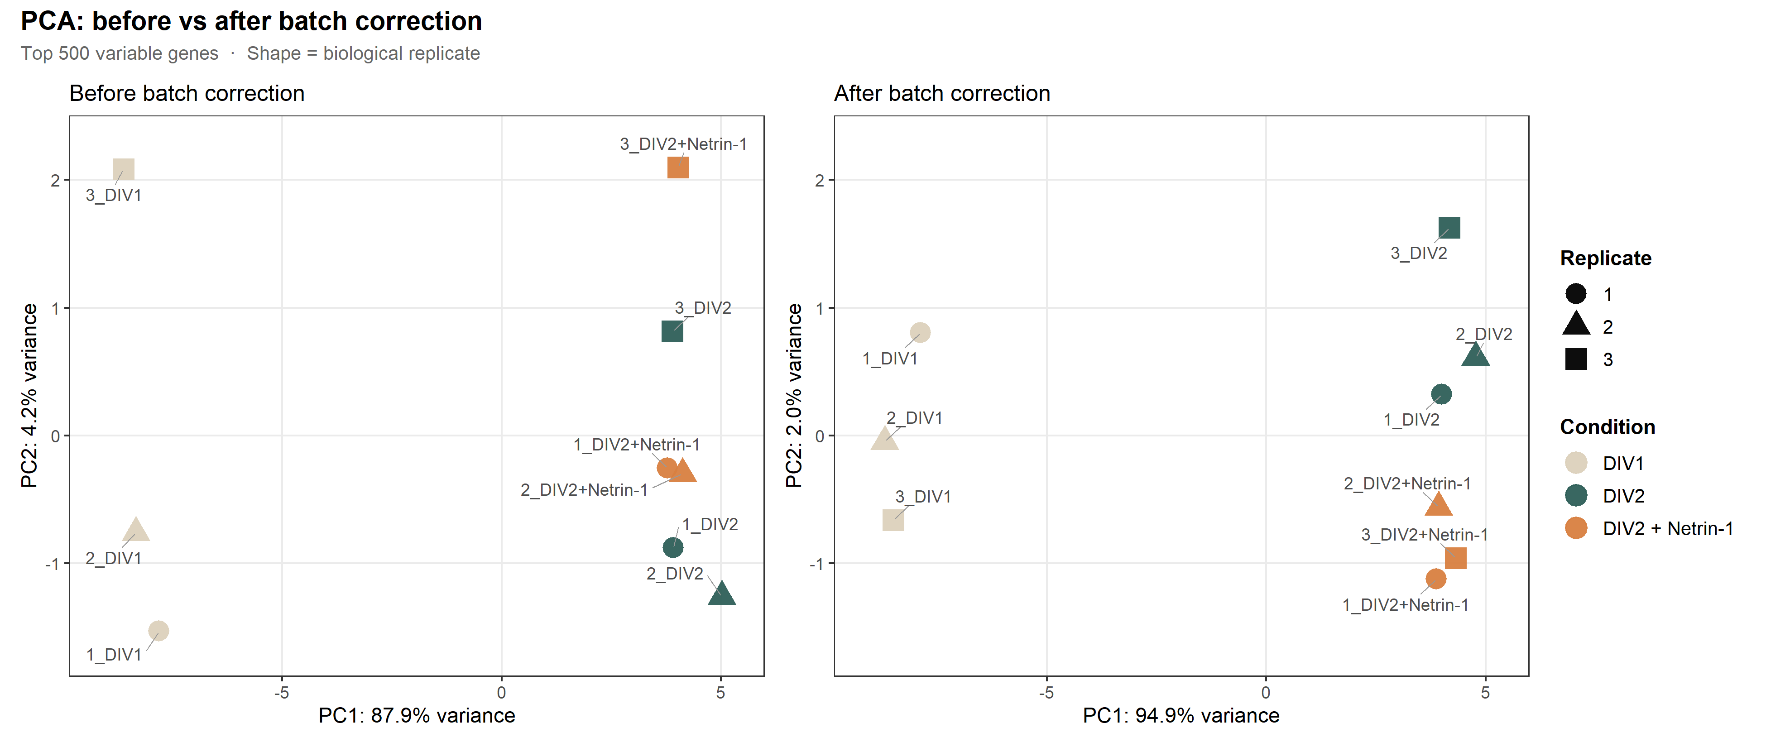
Experimental design and analysis pipeline
E18 rat cortical primary culture (mixed, no AraC); bulk RNA-seq, DRAGEN-Salmon gene-level.
3 conditions x 3 biological replicates: DIV1, DIV2 (vehicle), DIV2 + Netrin-1.
Contrasts: C1 = Netrin-1 vs DIV2 (treatment, primary); C2 = DIV2 vs DIV1 (development, secondary).
DESeq2 ~ batch + condition (DIV2 reference); raw LFC (no apeglm); BH FDR.
DEG tiers: STRICT padj<0.05 & |LFC|>0.585; RELAXED padj<0.05.
Enrichment: GSEA (Wald-ranked; minGSSize=15, nPerm=10000) + ORA; batch correction for display only.
Design: 3 conditions x 3 replicates
DIV1
DIV2
DIV2+Ntn
Rep 1
DIV1
DIV2
DIV2+Ntn
Rep 2
DIV1
DIV2
DIV2+Ntn
Rep 3
DIV1
DIV2
DIV2+Ntn
Batch correction (visualisation only): Netrin signal emerges on PC2; PC1 87.9% -> 94.9%.
Notes:
设计 3×3。DESeq2 ~batch+condition，DIV2 为参考；用 raw LFC（不做 apeglm 收缩，符合主流且避免火山图压缩）。STRICT=padj<0.05 且 |LFC|>0.585；RELAXED=padj<0.05。富集：GSEA（Wald 统计量排序）+ ORA。批次校正只用于可视化，统计仍在原始 counts 上。右图：校正后 PC1 87.9%→94.9%，Netrin 在 PC2 分开——发现时刻。

Slide 4
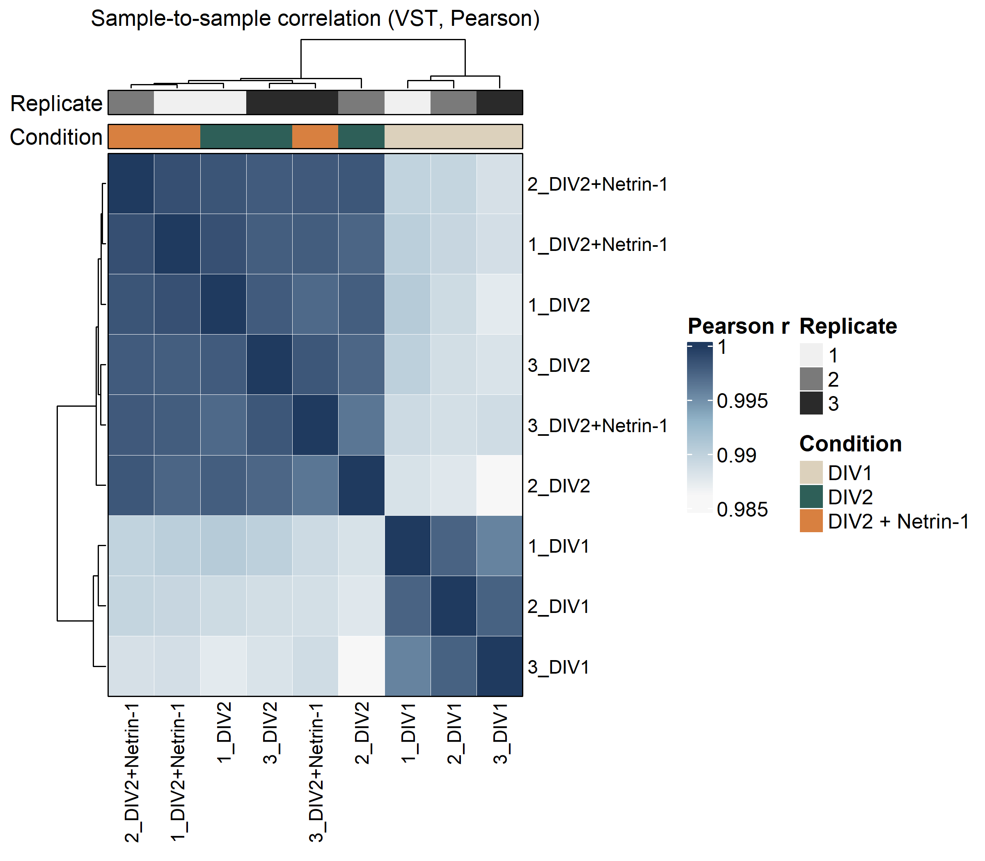
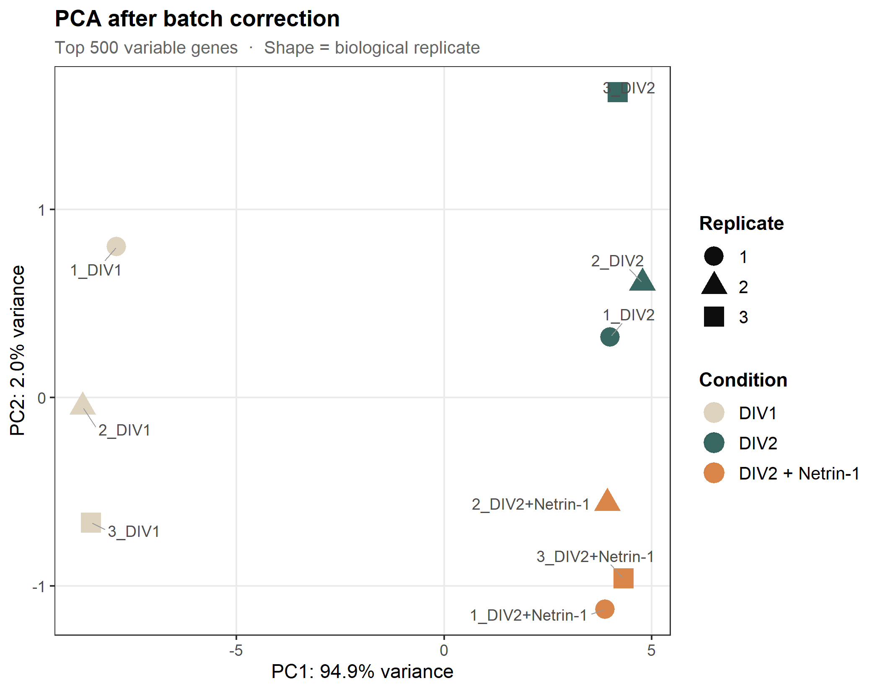
Quality control and the Netrin-1 discovery moment
All samples high quality: RIN >= 9 (8 of 9 = 10); 22.95-36.11 M quantified reads; 16,451-17,093 genes detected; 14,148 pass the low-count filter.
Sample correlation r = 0.9861-0.9987 (no outliers); size factors 0.74-1.16; median dispersion 0.0060 - replicates highly consistent.
After batch correction, DIV2 control and DIV2 + Netrin-1 separate on PC2 (PC1 = 94.9%) - the first direct view of the Netrin-1 signal.
Sample correlation (VST, Pearson)
PCA after batch correction
Notes:
质量过硬：RIN≥9（8/9=10）；每样本 22.95–36.11M quantified reads；检出 16,451–17,093 基因；过滤后 14,148。样本相关 r=0.9861–0.9987，无离群；size factor 0.74–1.16；中位 dispersion 0.0060，重复极一致。右图 PCA 校正后 DIV2 与 DIV2+Netrin 在 PC2 分开，首次直观显示 Netrin 信号。

Slide 5
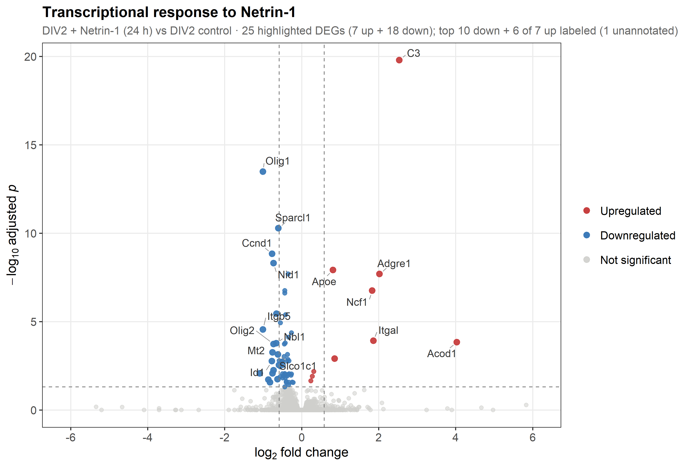
Contrast 1 - Netrin-1 elicits a focused, bidirectional response
STRICT: 25 DEGs (7 up + 18 down).
RELAXED: 66 DEGs (10 up + 56 down).
Asymmetric - more down than up.
Most significant down: Olig1 (LFC -1.00, padj 3.3e-14); also Olig2, Ccnd1, Sparcl1.
Most significant up: C3 (LFC +2.54, padj 1.6e-20); also Apoe, Adgre1, Ncf1, Itgal, Acod1.
Notes:
主对比聚焦且双向：STRICT 25（7↑/18↓），RELAXED 66。下调为主。最显著下调 Olig1（LFC -1.00，padj 3.3e-14），还有 Olig2/Ccnd1/Sparcl1；最显著上调 C3（+2.54，padj 1.6e-20）。注意：C3 是"最显著"非"最高表达"（Apoe baseMean 约其 5×）。

Slide 6
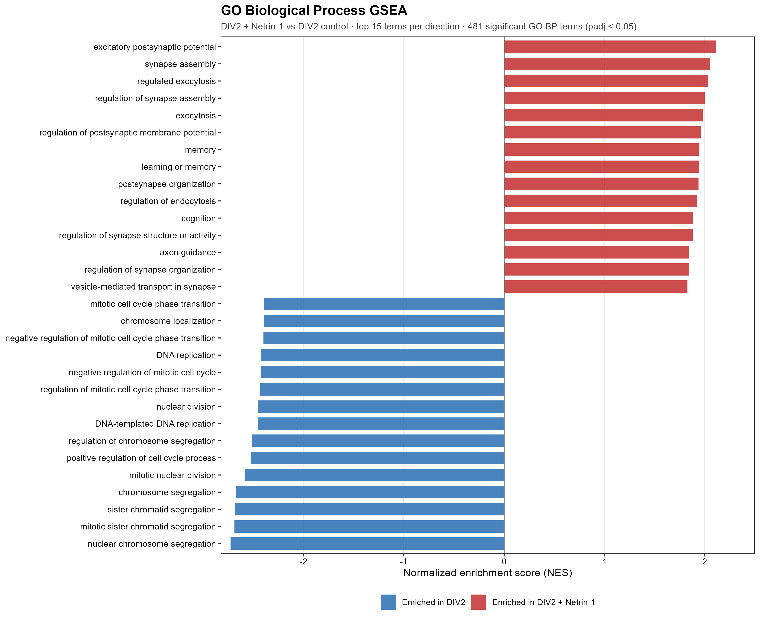
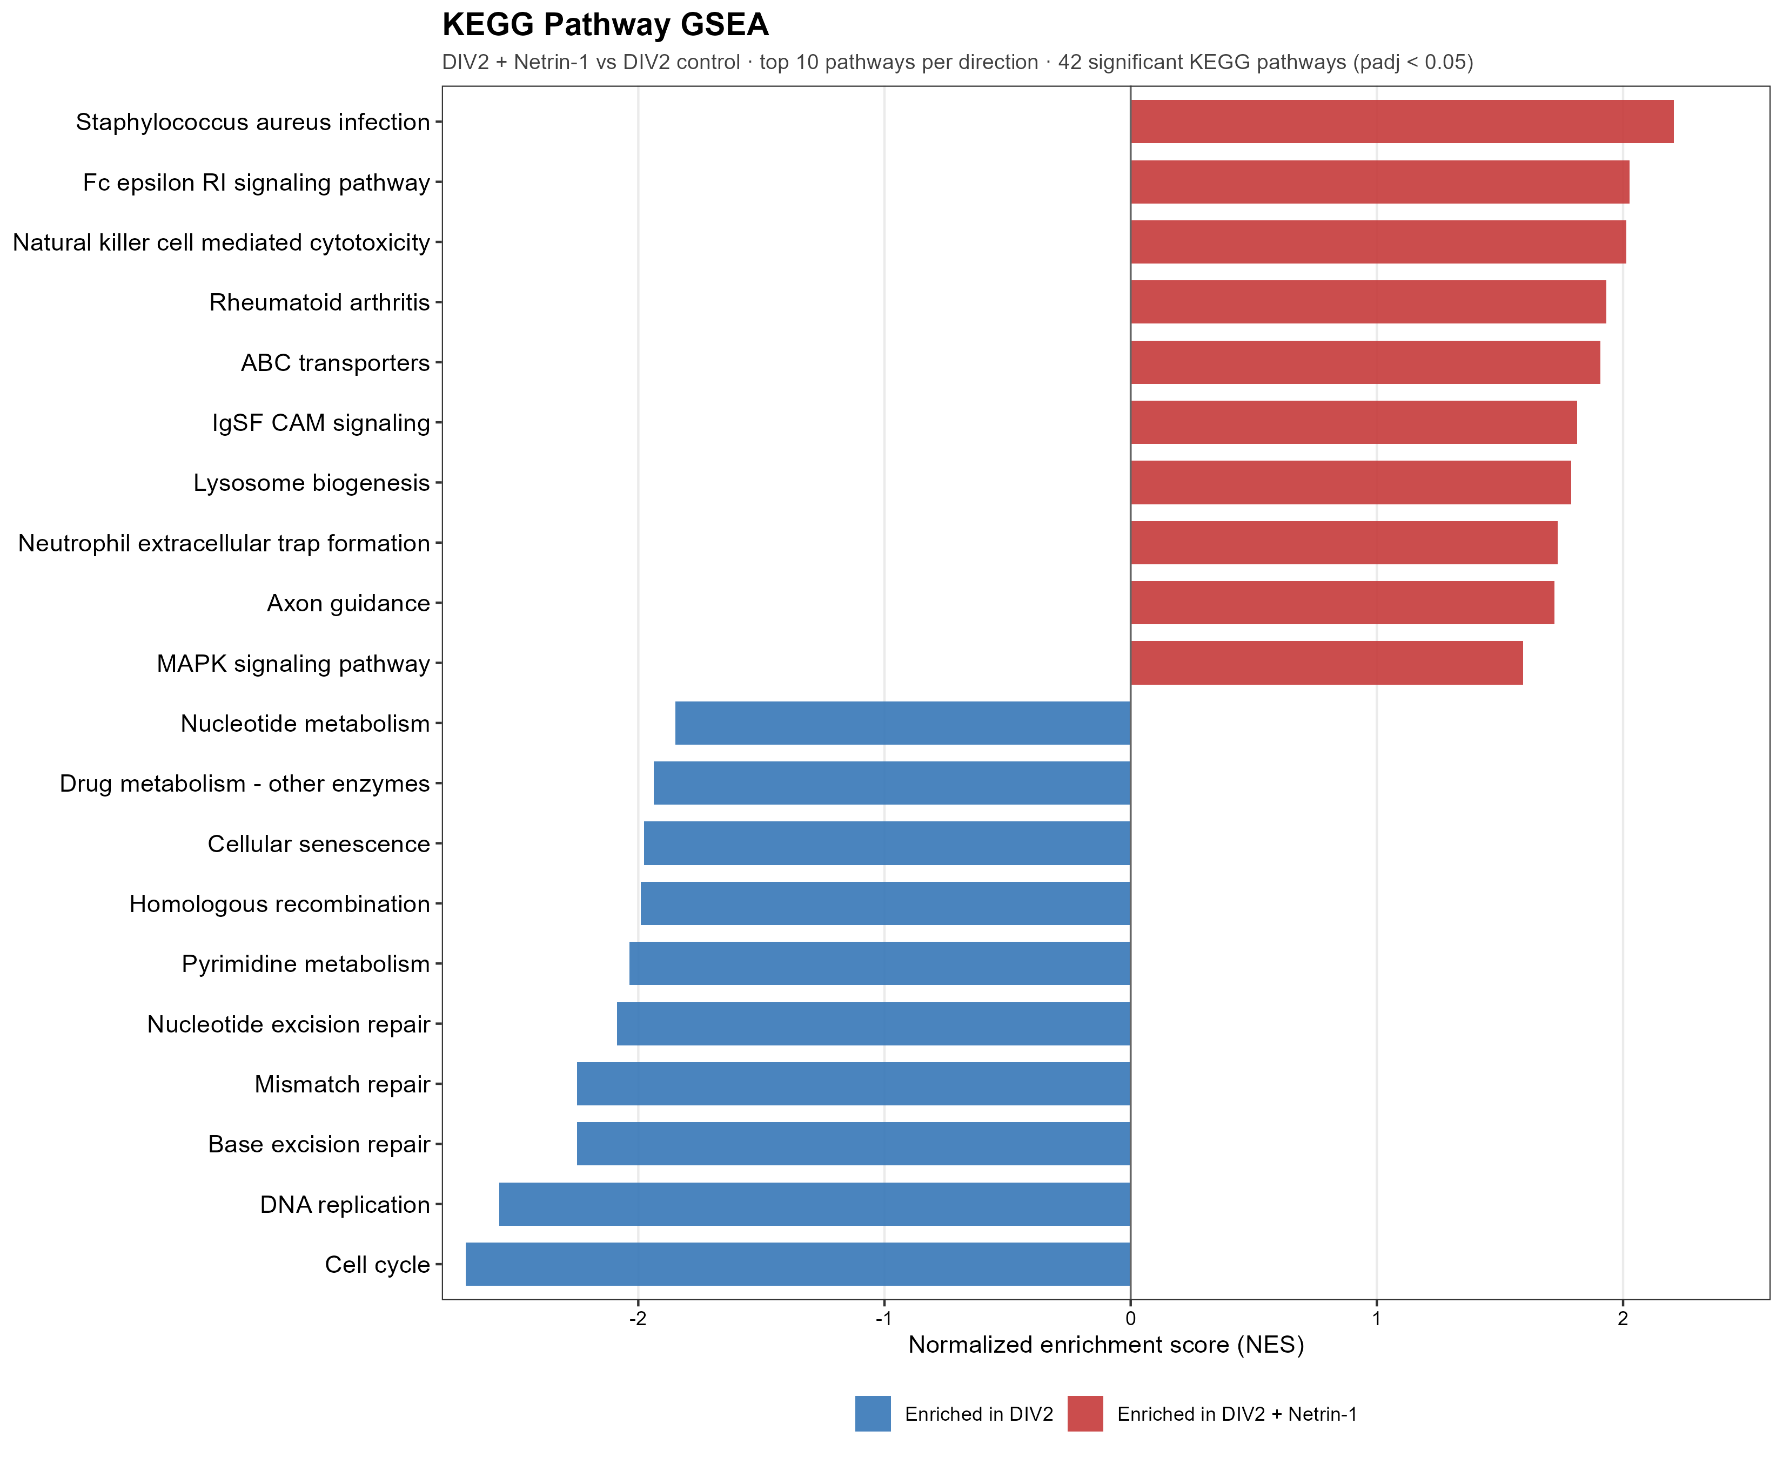
Contrast 1 GSEA - synaptic / axon-guidance up, cell cycle down
481 GO BP terms (255 activated / 226 suppressed) + 42 KEGG pathways (20 / 22) significant.
Activated: excitatory postsynaptic potential (NES +2.11), synapse assembly (+2.05), exocytosis, learning/memory, axon guidance (+1.85).
Suppressed: chromosome segregation / cell cycle / DNA replication (NES -2.4 to -2.7); KEGG Cell cycle NES -2.70 (padj 1.7e-8).
Convergent: axon guidance significant in BOTH GO BP (+1.85) and KEGG (+1.72) - Netrin engages its own pathway.
Notes:
无阈值 GSEA：481 GO BP（255 激活/226 抑制）+ 42 KEGG（20/22）显著。激活=突触/胞吐/学习记忆 + axon guidance；抑制=细胞周期/DNA 复制（KEGG Cell cycle NES -2.70，padj 1.7e-8）。核心：axon guidance 在 GO(+1.85) 与 KEGG(+1.72) 双重显著——Netrin 在转录层面 engage 自身通路。注：KEGG 疾病名是共享免疫机制基因，非疾病状态。

Slide 7
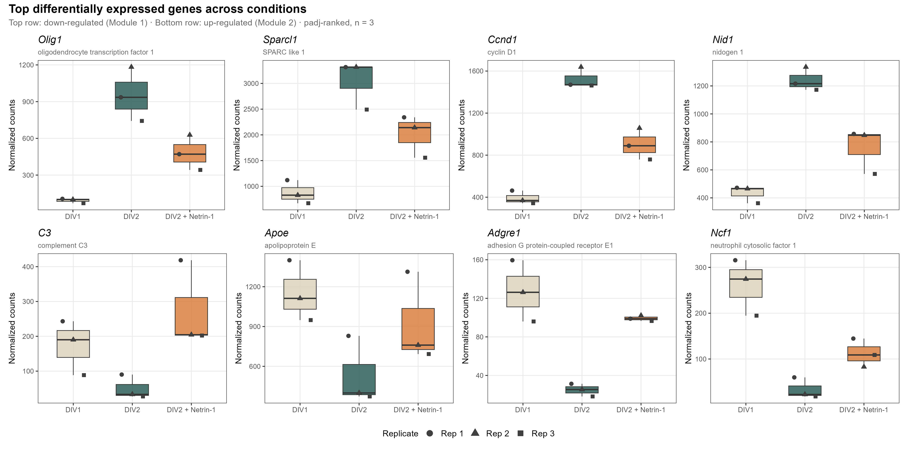
Contrast 1 - the strongest single-gene DEGs are largely glial / immune
Immune module up: C3, Adgre1, Apoe, Acod1.
Progenitor / glial module down: Olig1, Olig2, Sparcl1, Ccnd1.
Key nuance: these top per-gene hits map to microglia / glia, not neurons.
The neuronal axon-guidance / synapse signal is coordinated and subtle - visible at the gene-set (GSEA) level, not as single-gene hits.
Notes:
诚实框定：这些 top 单基因 DEG 多为 microglia/胶质来源（免疫 C3/Adgre1/Apoe/Acod1；祖细胞/胶质 Olig1/Olig2/Sparcl1/Ccnd1），不是神经元。神经元的 axon guidance/突触信号是协调而微弱的，只在 GSEA 层面显现。为后面细胞来源分析铺垫。

Slide 8
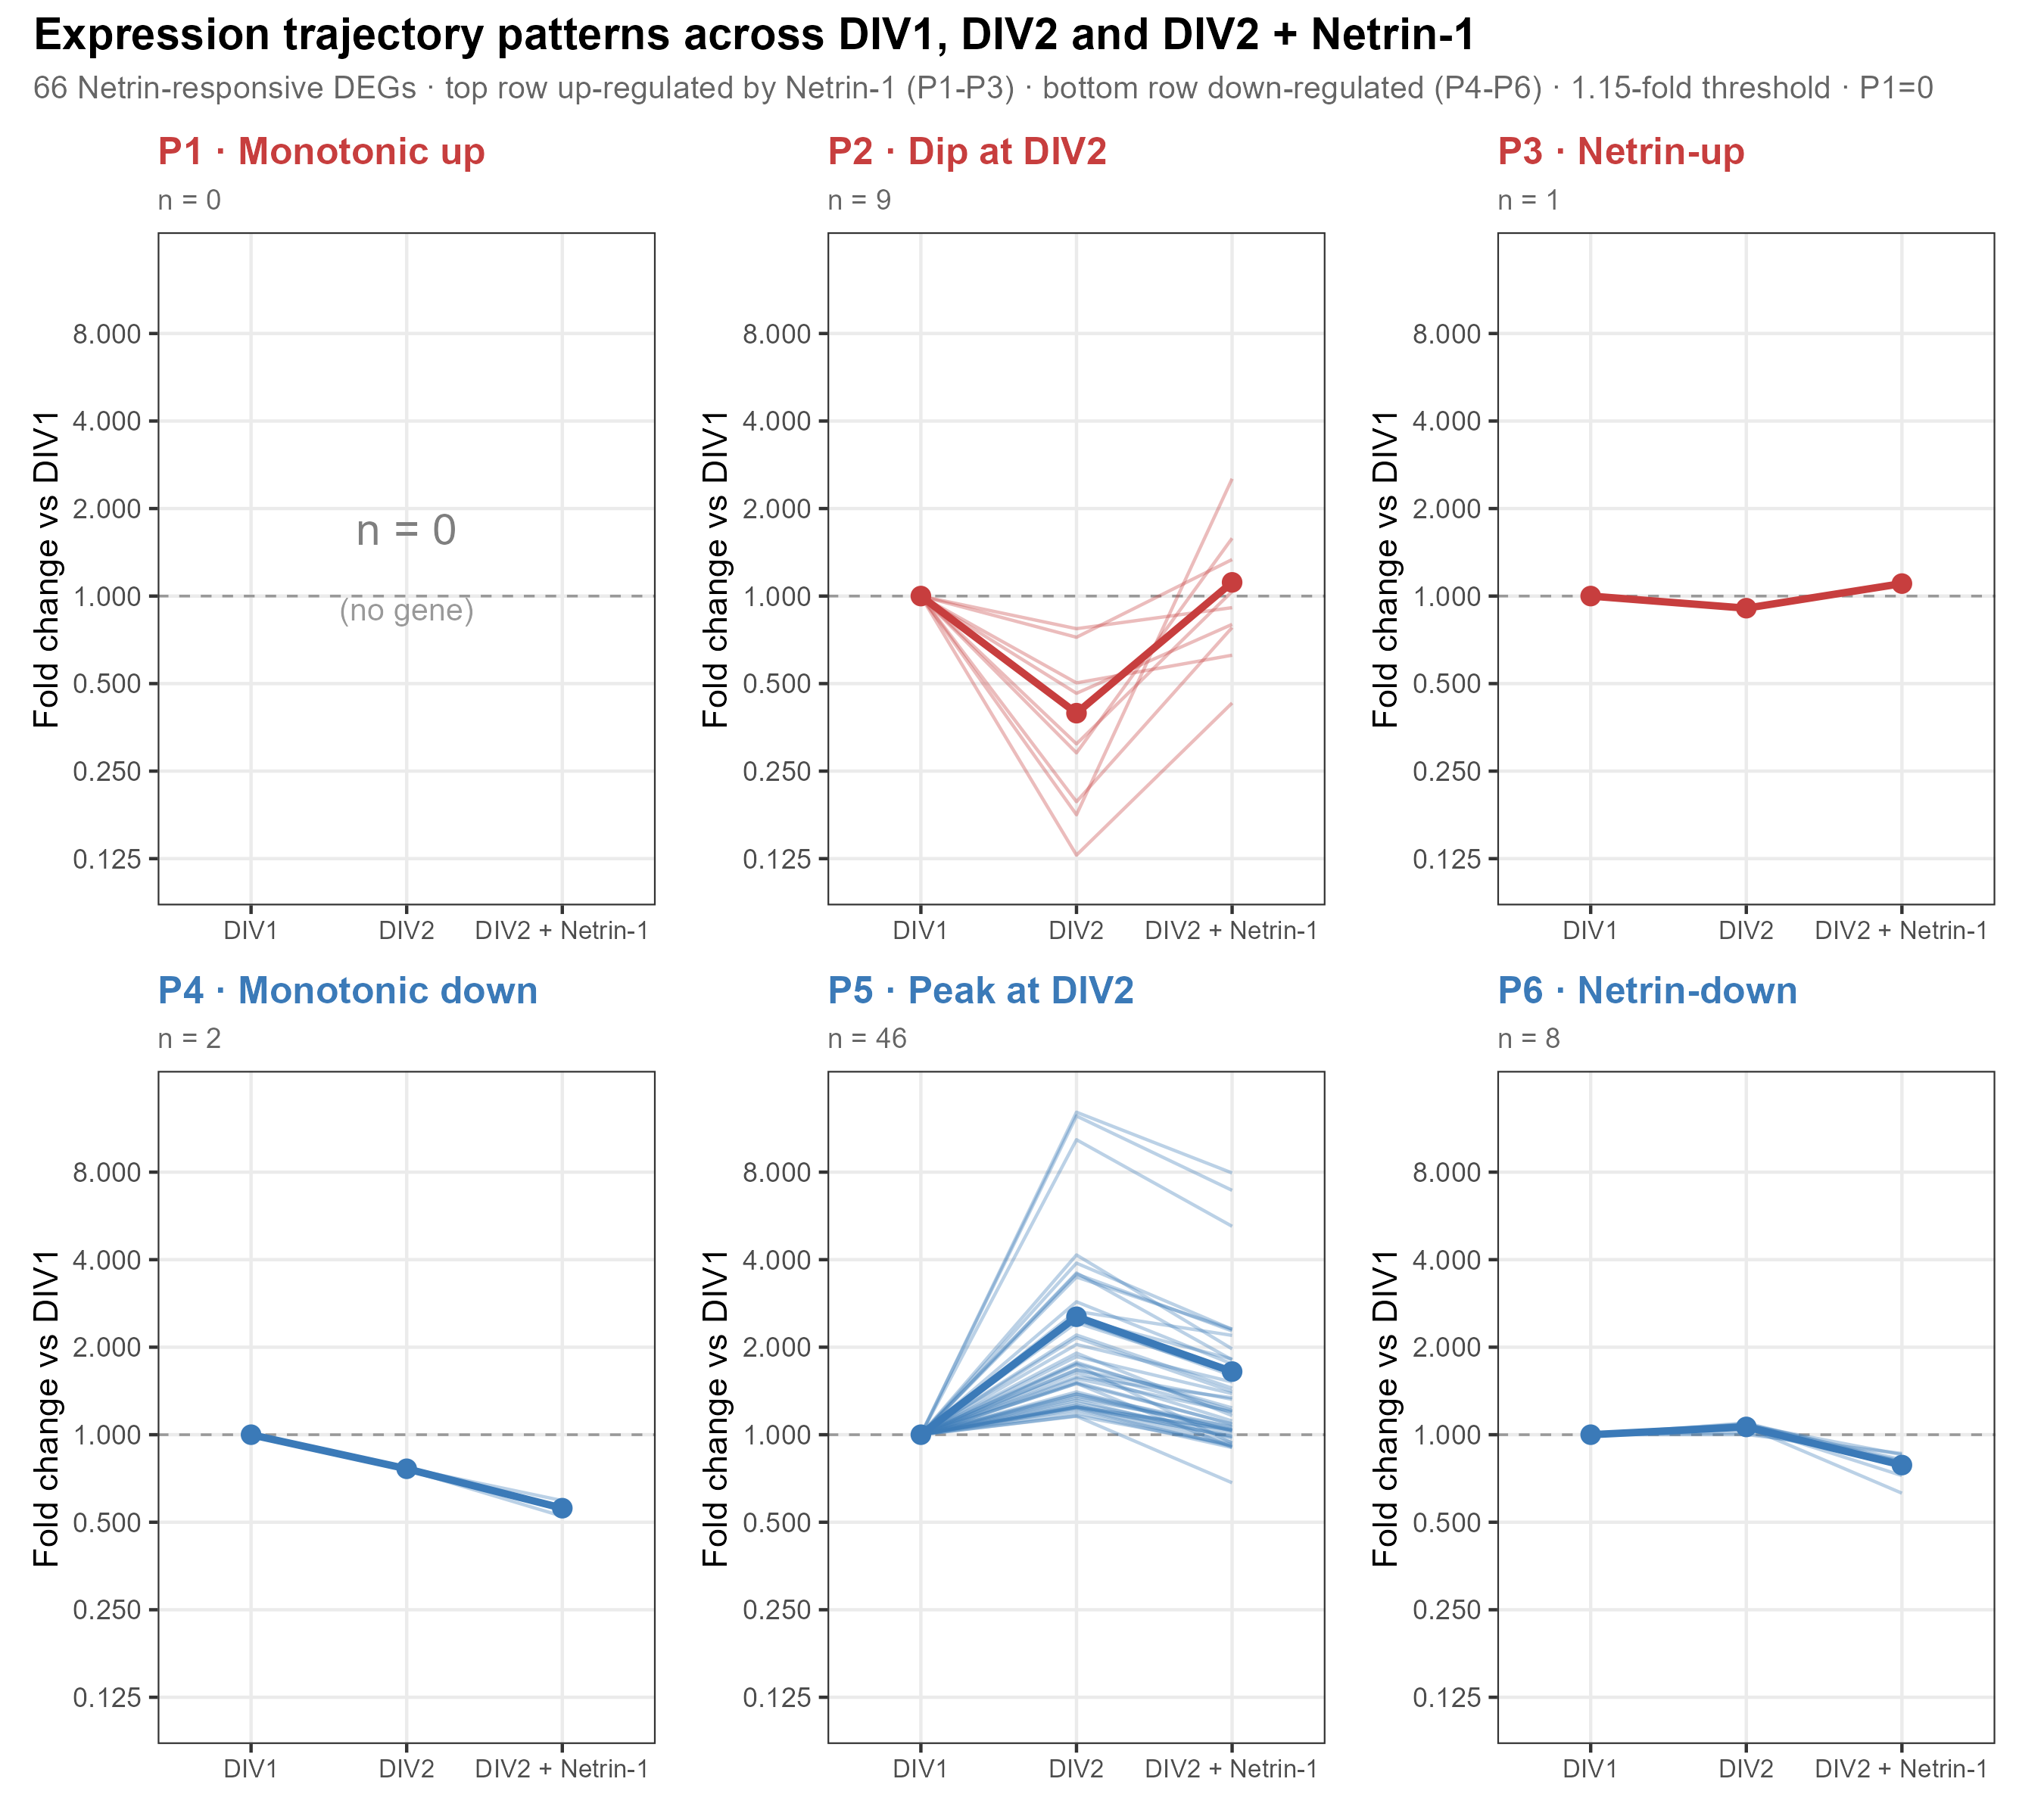
Pattern classification along DIV1 -> DIV2 -> DIV2 + Netrin-1
66 RELAXED DEGs classified into six trajectory patterns (DIV1 -> DIV2 -> Netrin).
Dominant: P5 - peak at DIV2 (n = 46) - induced in development, partially reversed by Netrin.
P2 - dip at DIV2 (n = 9, e.g. C3); P6 - Netrin-down (n = 8); P4 - monotonic down (n = 2); P3 - Netrin-up (n = 1).
Caveat: P5's prototypical genes Olig1/Olig2 are oligodendrocyte (glial) markers - so P5 mainly tracks glial/composition change (see cell-source slides), NOT neuron-intrinsic maturation.
Critically, P1 - monotonic up = 0 genes: no gene is accelerated along the trajectory.
Argues against a simple 'Netrin accelerates maturation' model -> motivates the gene-set (GSEA) analysis.
Notes:
把 66 个 RELAXED 基因按 DIV1→DIV2→Netrin 轨迹分成六型。主型 P5 峰在 DIV2（n=46）：发育中被诱导、被 Netrin 部分逆转。P2 谷在 DIV2（n=9，如 C3：先降后被 Netrin 再诱导超过 DIV1）；P6 Netrin 下调（n=8）；P4 单调下降（n=2）；P3 Netrin 上调（n=1）。【重要协调】P5 的代表基因 Olig1/Olig2 是少突胶质 marker，不是神经元——所以这一 pattern 主要反映胶质/细胞组成变化（见后面细胞组成/信号来源页），并非神经元内在成熟；讲解时务必和"Olig 是胶质"的结论保持一致，别让听众觉得矛盾。真正的结论是关键阴性：P1 单调上升=0——没有基因被沿发育轨迹加速，反对"Netrin 加速成熟"，促使做 gene-set 层面 GSEA。

Slide 9
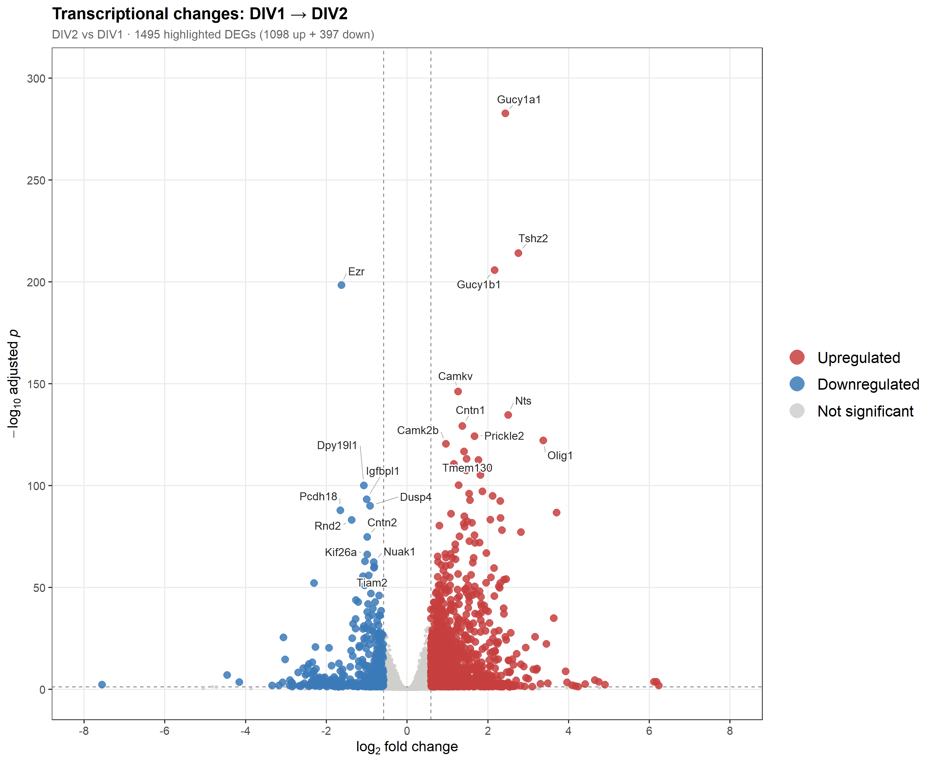
Contrast 2 - the 24 h developmental program (context)
STRICT: 1,495 DEGs (1,098 up + 397 down).
RELAXED: 4,636 DEGs (2,603 up + 2,033 down).
~Two orders of magnitude larger than C1 - development dominates.
Olig1 is up here (LFC +3.37), opposite to its down direction under Netrin: Netrin reverses the natural induction.
Interpret with caution: confounds 24 h development with vehicle exposure.
Notes:
次对比=24h 发育（含 vehicle），作背景。STRICT 1,495（1,098↑/397↓），RELAXED 4,636，比 C1 大两个数量级，发育主导。Olig1 在此 +3.37（注意 Olig 是少突胶质 marker，反映胶质扩张），与 Netrin 下的 -1.00 相反——Netrin 特异下调 Olig。谨慎：发育与 vehicle 混杂。

Slide 10
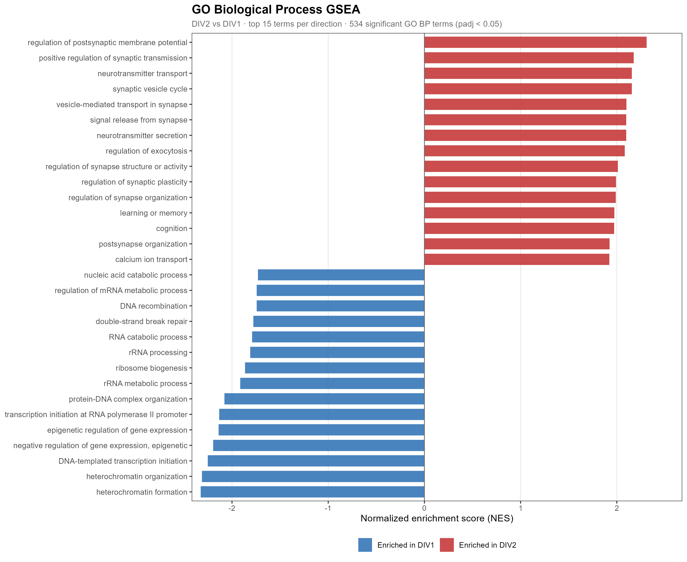
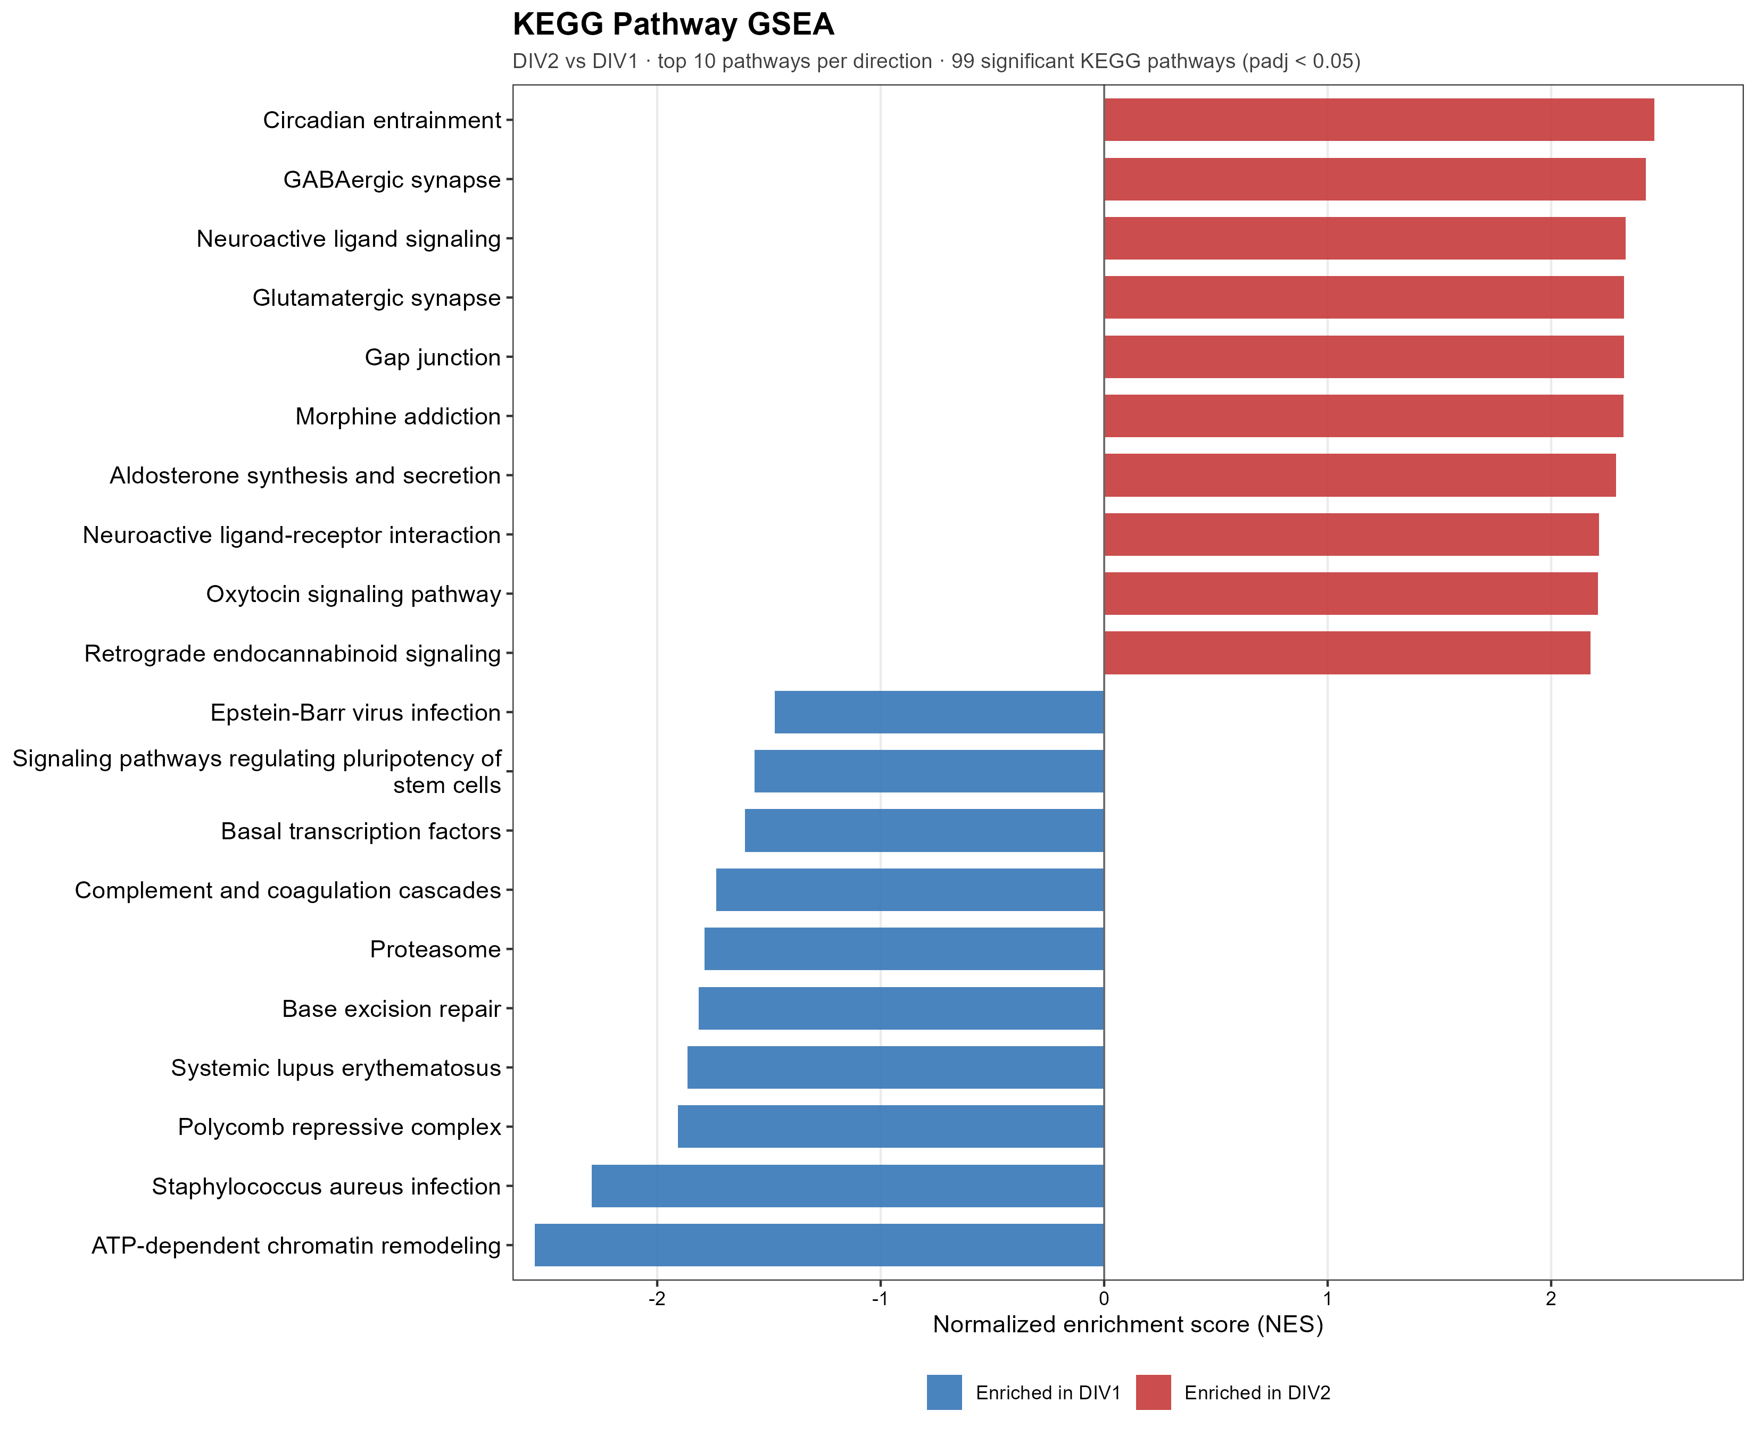
Contrast 2 GSEA - maturation up, precursor program down
534 GO BP terms (410 activated / 124 suppressed) + 99 KEGG (89 / 10) significant - skewed to activation.
DIV2-enriched (mature): synaptic transmission, neurotransmitter transport, plasticity, learning/memory; KEGG GABAergic / glutamatergic synapse.
DIV1-enriched (precursor): chromatin remodeling, ribosome biogenesis, rRNA processing, DNA repair; KEGG proteasome, stem-cell pluripotency.
Notes:
534 GO BP（410 激活/124 抑制）+ 99 KEGG（89/10），明显偏激活。DIV2 富集=成熟（突触传递/递质转运/可塑性/学习记忆；KEGG GABA能·谷氨酸能突触）；DIV1 富集=前体（染色质重塑/核糖体生物合成/rRNA 加工/DNA 修复）。经典前体→后有丝分裂转变。

Slide 11
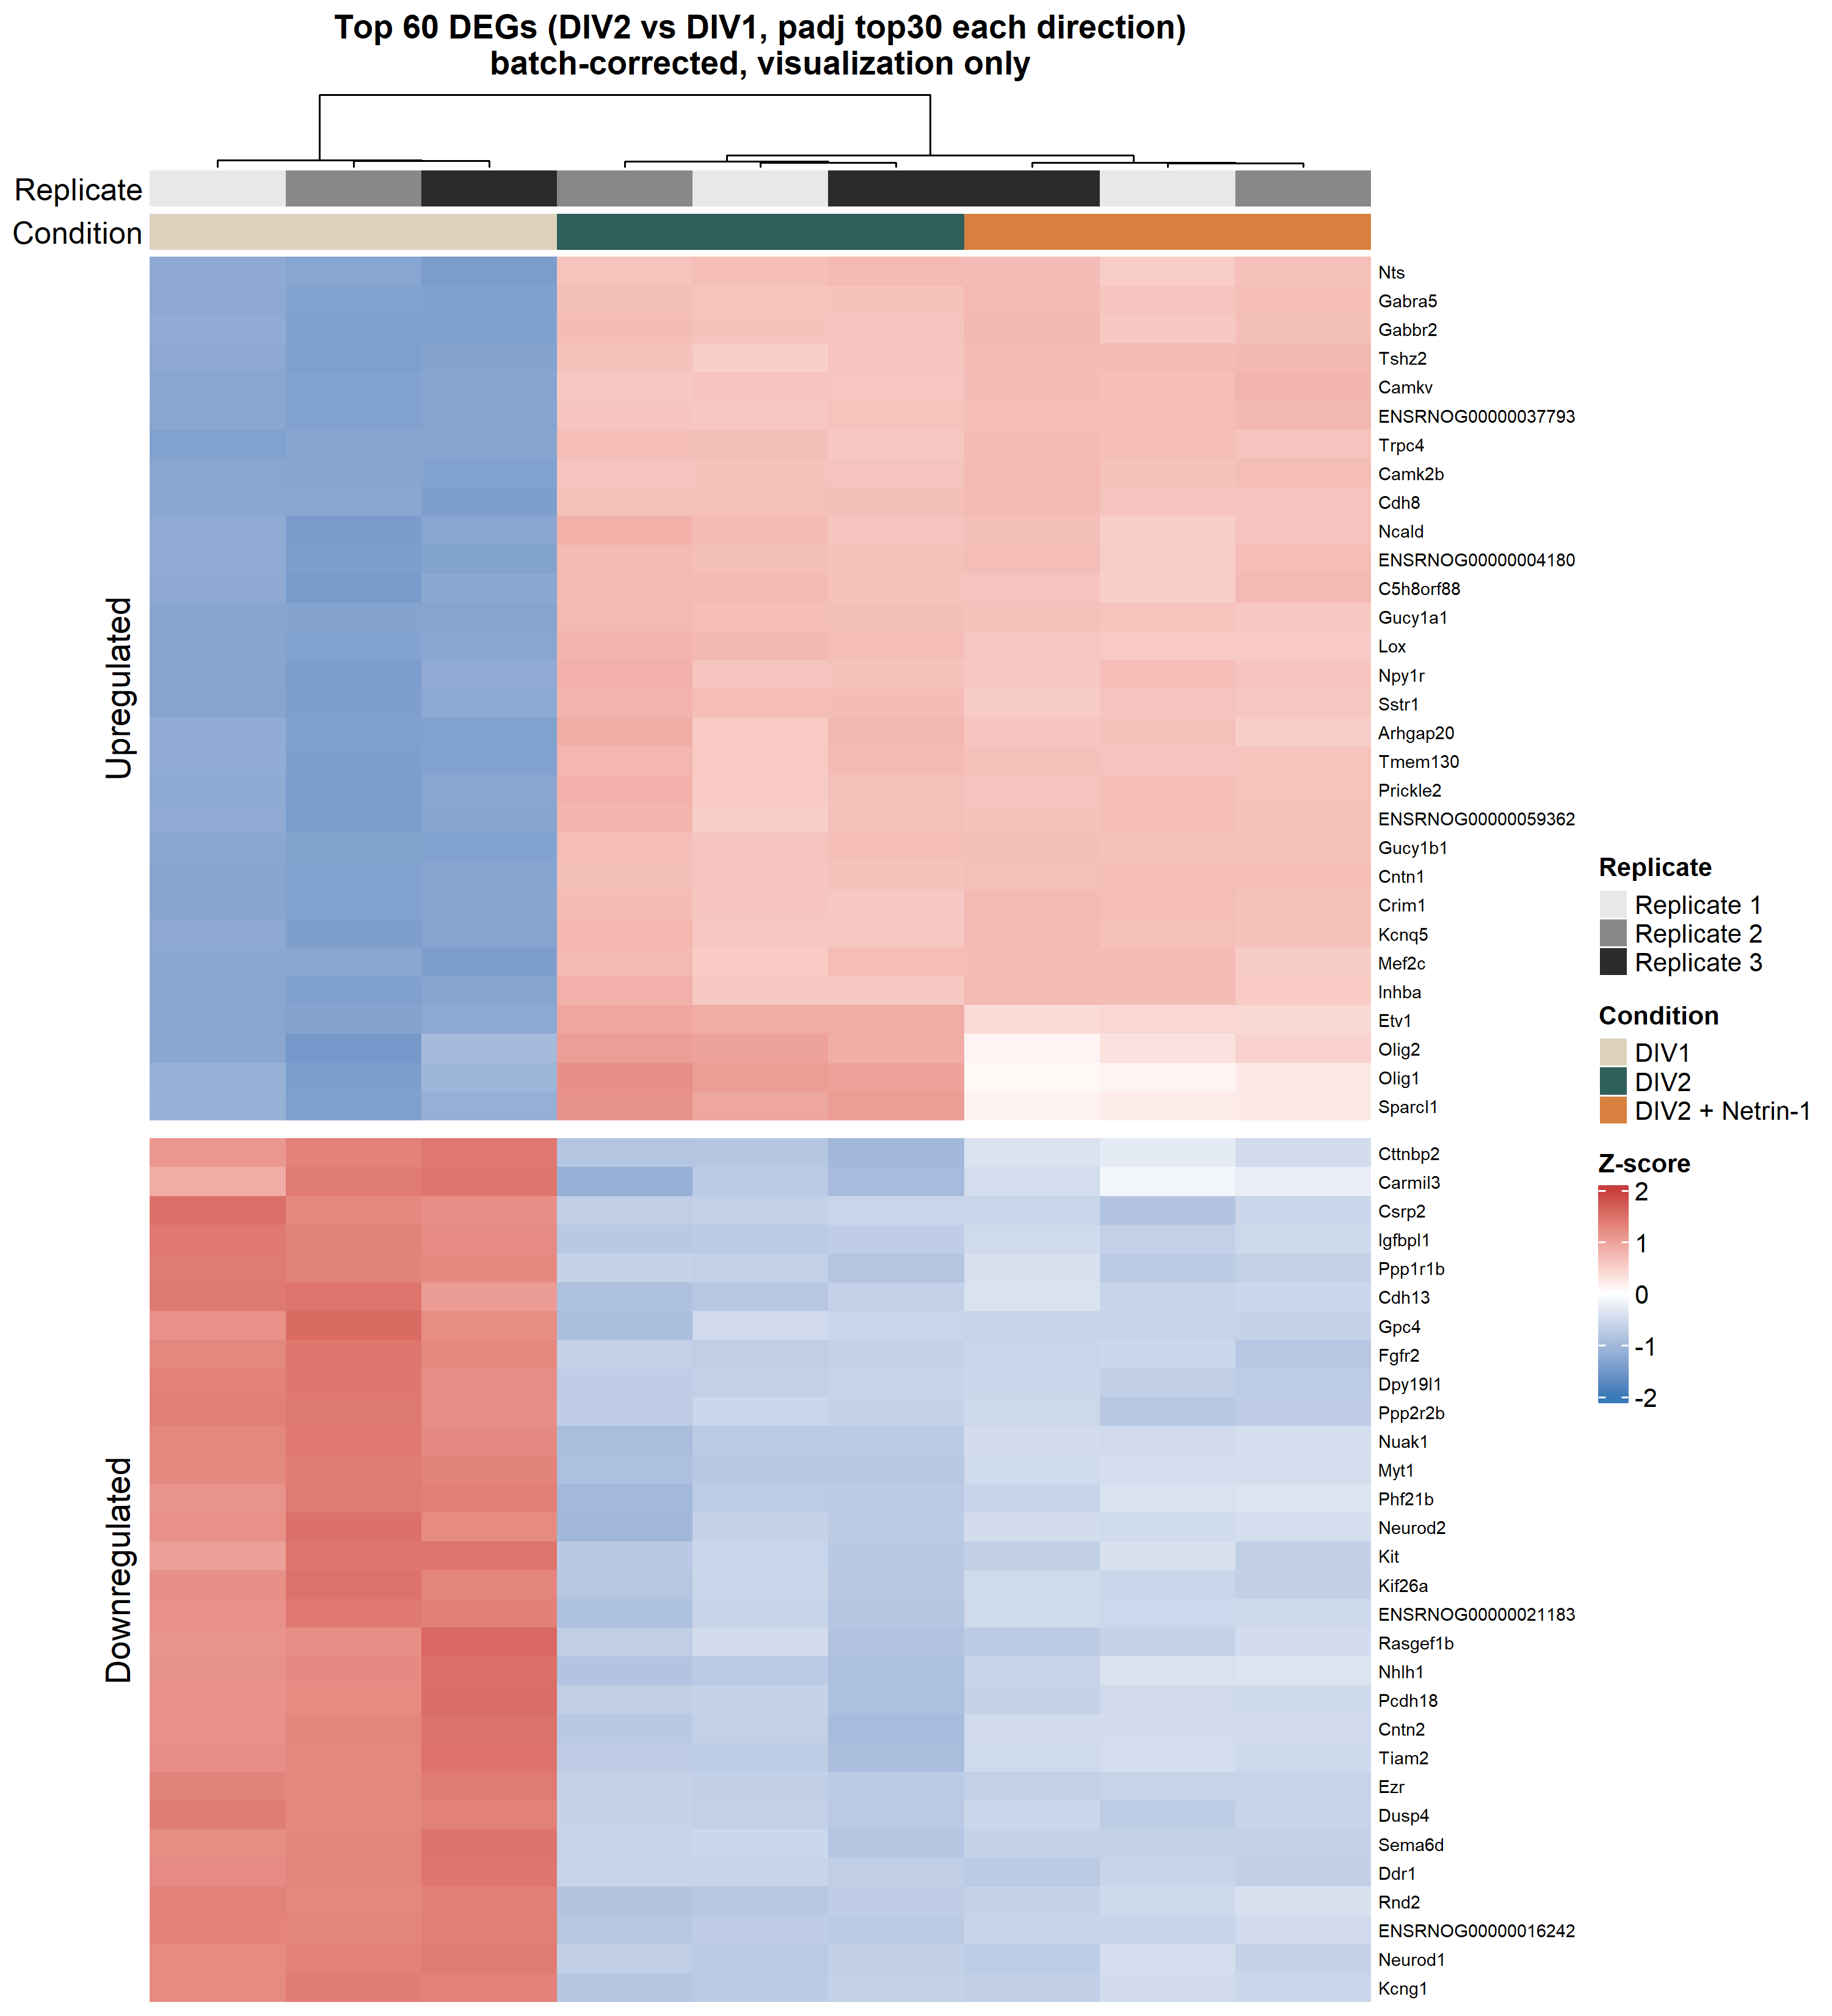
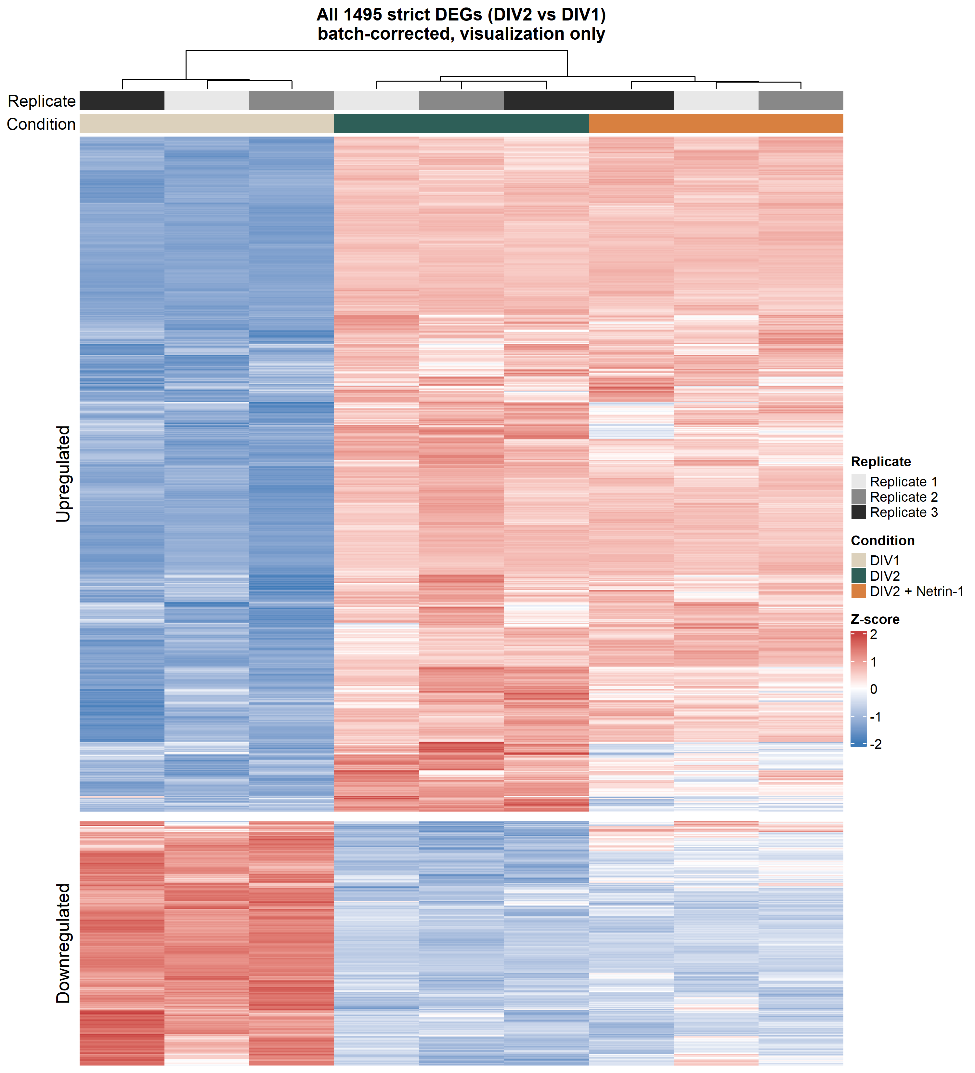
Contrast 2 - expression structure of the 1,495 strict DEGs
Column clustering: DIV1 separates from DIV2 + Netrin -> developmental difference >> Netrin effect.
Left: top-60 DEGs (30 / direction, gene-labelled). Right: all 1,495 (scale view).
Notes:
列聚类：DIV1 单独一支，DIV2 与 DIV2+Netrin 聚一支 → 发育差异 >> Netrin 效应。左：top60（标基因名）；右：全部 1,495（看规模）。

Slide 12
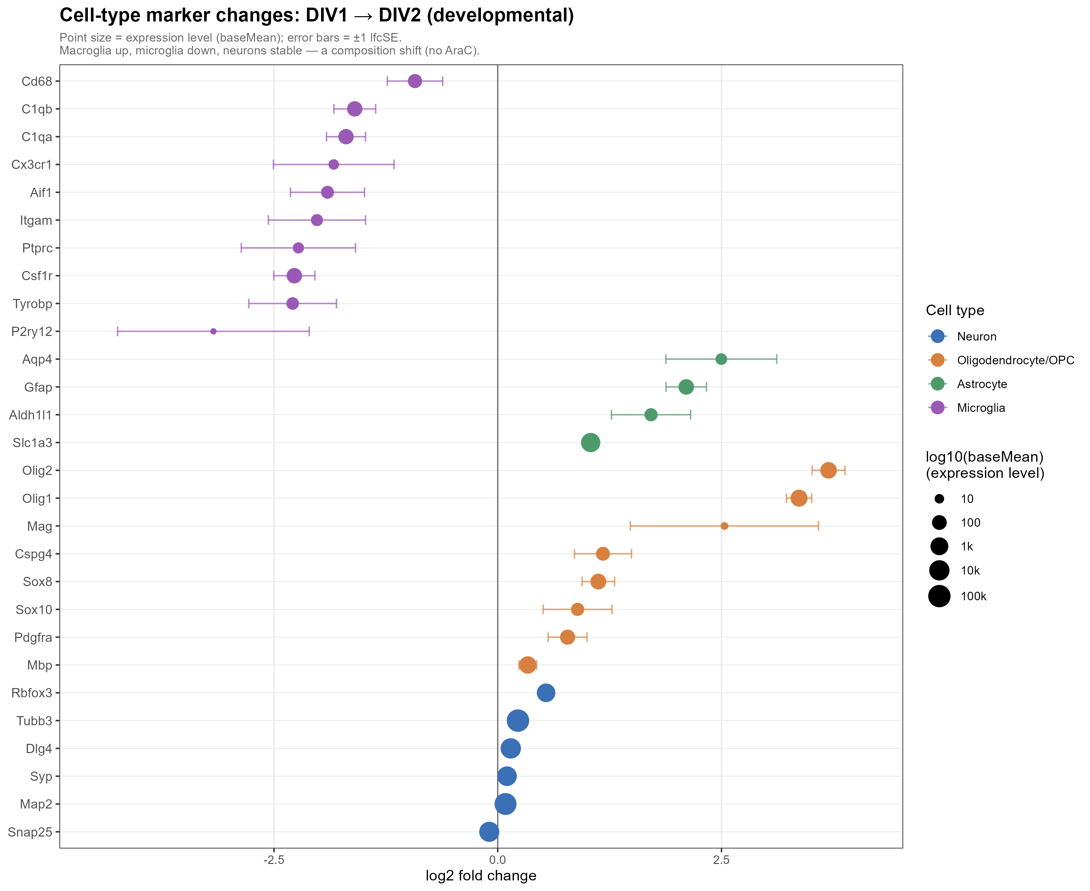
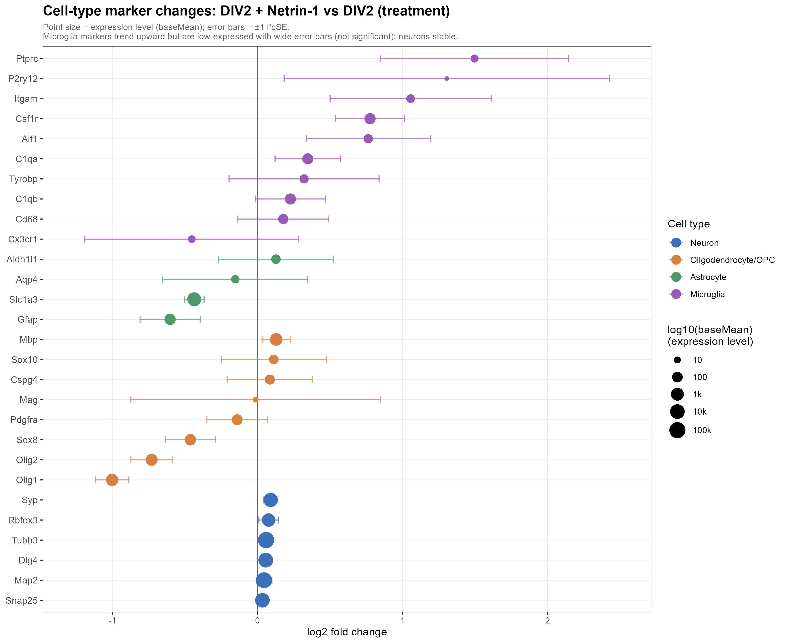
Cell-type composition shifts - reading bulk signals correctly
C2 (development): macroglia (oligo/OPC + astrocyte) UP, microglia DOWN, neuron markers ~0 -> a composition shift (no-AraC). Many C2 DEGs reflect composition, not neuron-intrinsic change.
C1 (treatment): composition stable; microglia markers only TREND up with wide error bars (not significant).
C2 (development)
C1 (Netrin treatment)
Notes:
重点页。C2：macroglia（少突/OPC+星形）↑、microglia↓、神经元 marker≈0 → 这是细胞组成 shift（无 AraC），很多 C2 的 DEG 反映组成而非神经元内在变化。C1：组成稳定，microglia marker 仅趋势↑且误差线宽、不显著。教我们如何正确读 bulk 信号。

Slide 13
Attributing signals: neuron (direct) vs microglia (indirect)
Neuronal & reliable: synapse / axon-guidance programs - glia do not express these (low confounder). This is the focus.
Microglial, not neuronal: immune genes (C3, Apoe, Adgre1, Ncf1) - up in C1 (activation) / down in C2 (microglia loss).
Receptors are mainly neuronal -> microglial response is likely an indirect, neuron-mediated (paracrine) effect; activation, not number.
Netrin-1
(exogenous)
Cortical neurons
Neo1 / Dcc / Dscam / Unc5a
Axon guidance / Synapse
(reliable main line)
direct
indirect (paracrine?)
Microglia
Immune / complement
C3 / Apoe / Ncf1 (secondary, honest)
Wording: 'consistent with microglial activation' - NOT 'Netrin activates microglia'.
Notes:
归因。神经元且可靠：突触/轴突导向（胶质不表达，confounder 小）——focus。microglia 非神经元：免疫基因（C3/Apoe/Adgre1/Ncf1）C1↑（激活）/C2↓（microglia 减少）。少突胶质程序（Olig1/2 等）属 macroglia，也非神经元。受体主要在神经元 → microglia 反应很可能是神经元介导的间接旁分泌效应。措辞红线：说 consistent with microglial activation，不要说 Netrin activates microglia。C1 是"激活"非"数量"：效应基因显著，身份 marker 仅趋势。

Slide 14
Receptor expression supports neurons as the direct target
Netrin receptors abundant (baseMean; median = 705).
Neo1, Dcc, Dscam, Unc5a far exceed the median -> neurons can directly respond.
In C1, receptors do not change with treatment -> classical activation through existing receptors.
Endogenous Ntn1 very low (baseMean 10.6) -> exogenous Netrin-1 is a clean, near-zero-background stimulus.
median 705
Neo1
9,413.0
Dcc
3,102.0
Dscam
1,936.0
Unc5a
1,591.0
Unc5d
1,210.0
Unc5c
427.0
Unc5b
166.0
Ntn1 (ligand)
10.6
Bar length proportional to log10(baseMean).
Notes:
支撑"神经元=直接靶点"。受体丰富（baseMean，中位 705）：Neo1 9413、Dcc 3102、Dscam 1936、Unc5a 1591 远超中位。C1 受体不随处理变 → 经典激活。内源 Ntn1 仅 10.6 → 外源 Netrin 是近零背景的干净刺激。图为 log10(baseMean) 柱状，橙色虚线=中位 705。

Slide 15
Netrin = balanced bidirectional tuning; development = unidirectional activation
C1 (Netrin): GO BP 481 (255 act / 226 sup), KEGG 42 (20 / 22) - about 1:1, bidirectional.
C2 (development): GO BP 534 (410 act / 124 sup), KEGG 99 (89 / 10) - activation-skewed.
Mirrors the DEG level (C2 strict 1,098 up >> 397 down): development opens neuronal programs en masse; Netrin fine-tunes both ways.
activated
suppressed
GSEA GO BP (significant terms)
GSEA KEGG (significant)
410
89
~1:1
255
226
124
20
22
10
Netrin (C1)
Development (C2)
Netrin (C1)
Development (C2)
Notes:
整合。C1（Netrin）：GO 481=255/226、KEGG 42=20/22，约 1:1，双向微调。C2（发育）：GO 534=410/124、KEGG 99=89/10，偏激活。呼应 DEG 层面（C2 strict 1,098↑>>397↓）：发育大规模开启神经程序，Netrin 双向精调。

Slide 16
Conclusions
Netrin-1 drives a focused, bidirectional, two-module transcriptional response in DIV2 cortical neurons.
Coordinated ACTIVATION of synaptic / axon-guidance programs + SUPPRESSION of cell-cycle / progenitor programs.
Axon guidance is enriched across GO BP and KEGG - Netrin transcriptionally reinforces its own pathway.
Neurons are the direct target (abundant receptors); the immune signature is microglial and likely an indirect, neuron-mediated effect.
Notes:
结论：Netrin 在 DIV2 神经元引发聚焦、双向、双模块响应——突触/轴突导向激活 + 细胞周期/祖细胞抑制。axon guidance 跨 GO/KEGG 收敛=Netrin 转录强化自身通路。神经元是直接靶点（受体丰富）；免疫信号来自 microglia，很可能是间接的神经元介导效应。

Slide 17
Limitations
Mixed culture + bulk RNA-seq cannot directly assign cell-of-origin; attributions are inferred from marker behaviour.
Contrast 2 carries a developmental composition shift (macroglia up / microglia down) - many DEGs reflect composition, not neuron-intrinsic development.
'Activation vs number' and 'direct vs indirect' are not fully resolved; findings are correlational, not causal.
Notes:
局限：①混合培养+bulk 无法直接分配细胞来源，归因基于 marker 推断；②C2 伴发育性组成 shift（macroglia↑/microglia↓），大量 DEG 非神经元内在；③"激活 vs 数量"、"直接 vs 间接"未终证，为相关非因果。

Slide 18
Future directions & acknowledgments
scRNA-seq or sorted populations to resolve per-cell-type contributions.
Immunostaining (IHC) to confirm microglial activation and composition shift.
Receptor perturbation (DCC / UNC5B knockdown) to test direct dependence.
LPS controls (polymyxin B / TLR inhibitors) for the immune signature.
Acknowledgments: [lab / funding / collaborators].
Notes:
未来：scRNA-seq / 细胞分选解析各细胞类型贡献；免疫染色（IHC）验证 microglia 激活与组成 shift；受体扰动（DCC/UNC5B 敲低）检验直接依赖；LPS 对照（polymyxin B / TLR 抑制剂）排查免疫信号。致谢：实验室 / 经费 / 合作者。

